Slide 1

MODULE 2: BASIC EXCEL SKILLS

Slide 2
Session Objectives
By the end of the presentation the participants should be able to:
Assess Excel Folders, files and sheets
Demonstrate Basic skills for Managing data: e.g.
Making a row wider (Row Height)
Add rows
Duplicate and/or copying Rows and Cell containing formulae
Changing font sizes
Hiding and un-hiding rows
Utilize Cell Outlines/Grouping features (“+” and “-“)
Working with Excel functions & formulae
Inserting notes and comments
Setting print areas

Slide 3
INTRODUCTION TO MS-EXCEL
Excel is a computer program used to create electronic spreadsheets.
Within excel user can organize data ,create chart and perform calculations.
Excel is a convenient program because it allow user to create large spreadsheets, reference information, and it allows for better storage of information.
Excels operates like other Microsoft(MS) office programs and has many of the same functions and shortcuts of other MS programs.

Slide 4
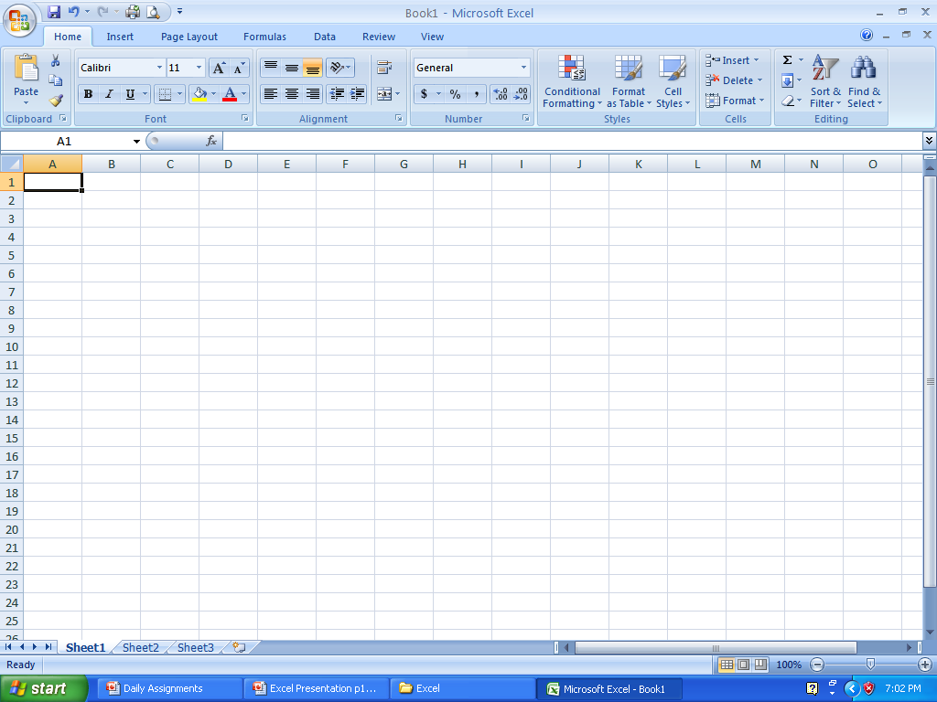
Overview of Excel Window 2010v
Quick Access Toolbar
Title Bar
Office
Button
Ribbon
Name Box w/active cell reference
heavy border surrounds active cell
Formula Bar
Select All Button
highlighted row & column headings indicate cell A1 is active
Scroll Bars
Sheet Tabs
Auto Calculate Area
Mode Indicator
Status Bar

Slide 5
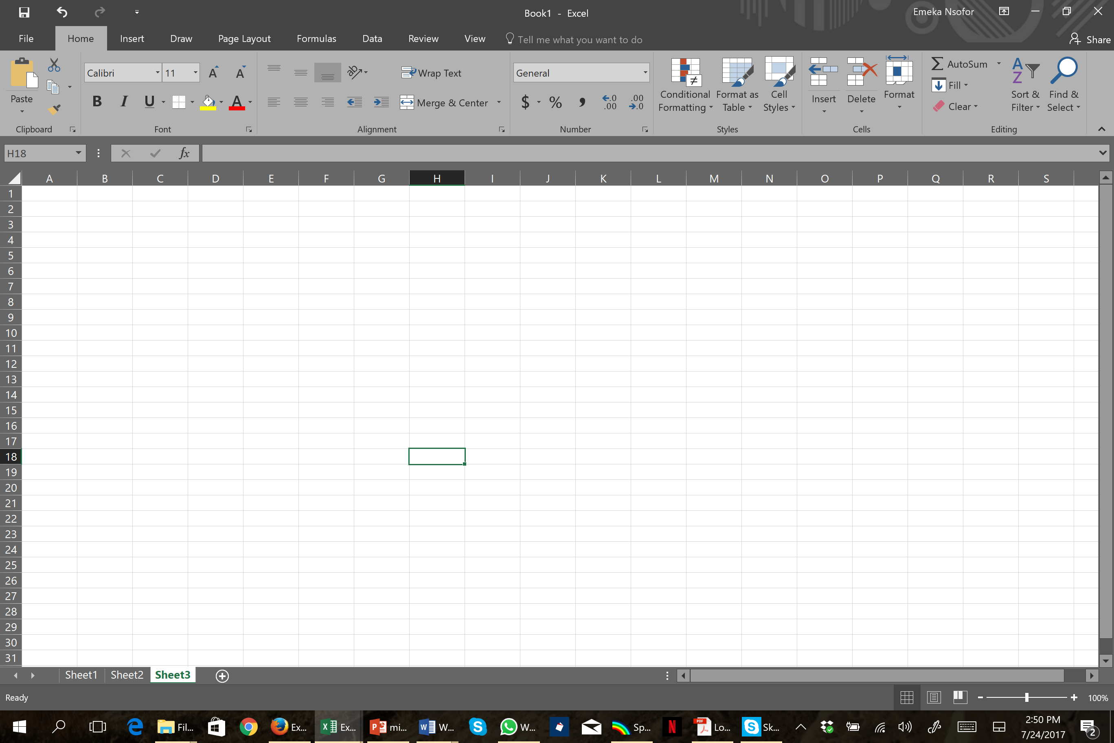
Overview of Excel Window 2016v
Quick Access Toolbar
Title Bar
Office
Button
Ribbon
Name Box w/active cell reference
Formula Bar
Select All Button
highlighted row & column headings indicate cell A1 is active
heavy border surrounds active cell
Scroll Bars
Sheet Tabs
Auto Calculate Area
Mode Indicator
Status Bar

Slide 6

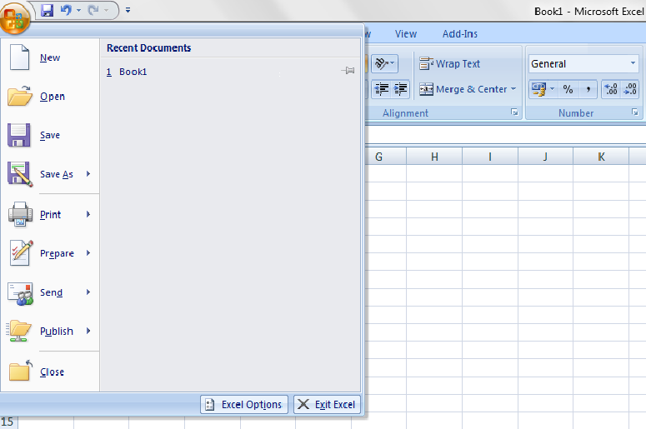
OFFICE BUTTON CONTAINS..
OFFICE BUTTON
NEW-TO OPEN NEW WORKBOOK. (CTRL+N)
OPEN-TO OPEN EXISTING DOCUMENT (CTRL+O)
SAVE-TO SAVE A DOCUMENT. (CTRL+S)
SAVE AS-TO SAVE COPY DOCUMENT. (F12)
PRINT-TO PRINT A DOCUMENT. (CTRL+P)
PREPARE-TO PREPARE DOCUMENT FOR DISTRIBUTION.
SEND-TO SEND A COPY OF DOCUMENT TO OTHER PEOPLE.
PUBLISH-TO DISTRIBUTE DOCUMENT TO OTHER PEOPLE.
CLOSE-TO CLOSE A DOCUMENT (CTRL+W).

Slide 7
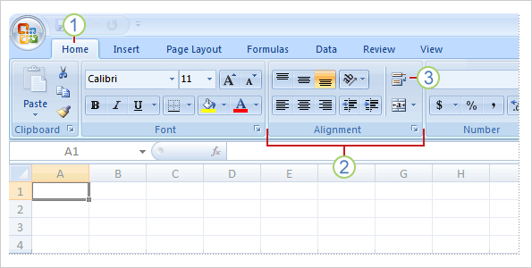



R I B B O N S
THE THREE PARTS OF THE RIBBON ARE
TABS
TABS:THERE ARE SEVEN TABS ACROSS THE TOP OF THE EXCEL WINDOW.
GROUPS: GROUPS ARE SETS OF RELATED COMMANDS,DISPLAYED ON TABS.
COMMANDS: ARE REPRESENTED AS BUTTON, IN A MENU OR A BOX WHERE YOU ENTER INFORMATION.
GROUPS
COMMANDS

Slide 8
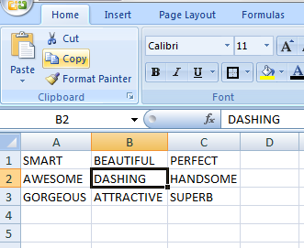
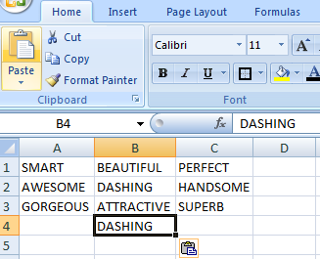
WORKING WITH CELLS
TO COPY AND PASTE CONTENTS:
Select the cell or cells you wish to copy.
Click the Copy command in the Clipboard group on the Home tab.
Select the cell or cells where you want to paste the information.
Click the Paste command.
The copied information will now appear in the new cells.
Or use the shortcut Control “C” to copy and Control “V” to Paste

Slide 9
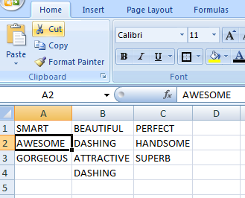
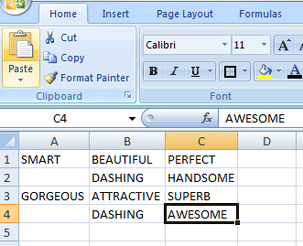
WORKING WITH CELLS
To Cut and Paste Cell Contents:
Select the cell or cells you wish to cut.
Click the Cut command in the Clipboard group on the Home tab.
Select the cell or cells where you want to paste the information.
Click the Paste command.
The cut information will be removed and now appear in the new cells.

Slide 10
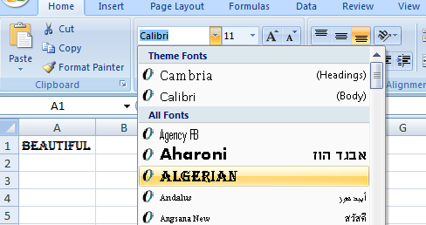
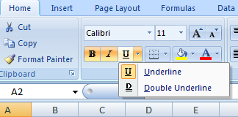
FORMATTING TEXT
TO FORMAT TEXT IN BOLD, ITALICS OR UNDERLINE:
Left-click a cell to select it or drag your cursor over the text in the formula bar to select it.
Click the Bold, Italics or underline command.
TO CHANGE THE FONT STYLE:
Select the cell or cells you want to format.
Left-click the drop-down arrow next to the Font Style box on the Home tab.
Select a font style from the list.

Slide 11
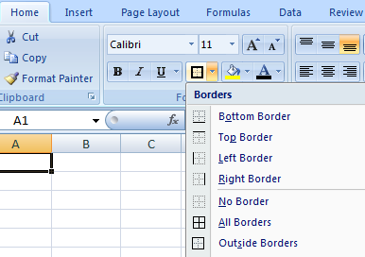
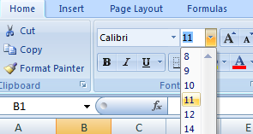
FORMATTING TEXT
TO CHANGE THE FONT SIZE:
Select the cell or cells you want to format.
Left-click the drop-down arrow next to the Font Size box on the Home tab.
Select a font size from the list.
TO ADD A BORDER:
Select the cell or cells you want to format.
Click the drop-down arrow next to the Borders command on the Home tab. A menu will appear with border options.

Slide 12
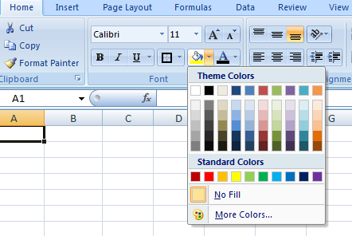
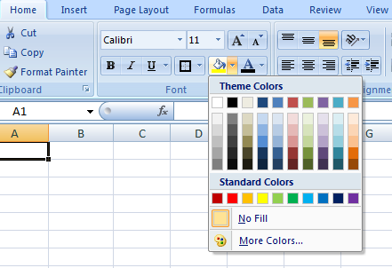
FORMATTING TEXT
TO CHANGE THE TEXT COLOUR:
Select the cell or cells you want to format.
Left-click the drop-down arrow next to the Text Color command. A color palette will appear.
Select a color from the palette.
TO ADD A FILL COLOUR:
Select the cell or cells you want to format.
Click the Fill command. A color palette will appear.
Select a color from the palette.

Slide 13
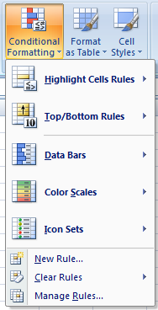
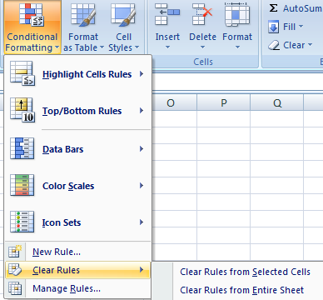
CONDITIONAL FORMATTING
TO APPLY CONDITIONAL FORMATTING:
Select the cells you would like to format.
Select the Home tab.
Locate the Styles group.
Click the Conditional Formatting command. A menu will appear with your formatting options.
TO REMOVE CONDITIONAL FORMATTING:
Click the Conditional Formatting command.
Select Clear Rules.
Choose to clear rules from the entire worksheet or the selected cells.

Slide 14
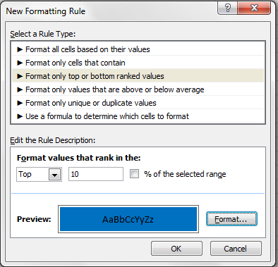
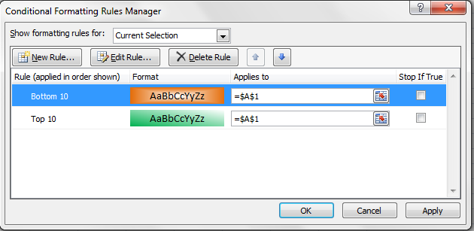
CONDITIONAL FORMATTING
TO APPLY NEW FORMATTING:
Click the Conditional Formatting command. Select New Rules from the menu. There are different rules, you can apply these rules to differentiate particular cell.
TO MANAGE CONDITIONAL FORMATTING:
Click the Conditional Formatting command.
Select Manage Rules from the menu. The Conditional Formatting Rules Manager dialog box will appear. From here you can edit a rule, delete a rule, or change the order of rules.

Slide 15
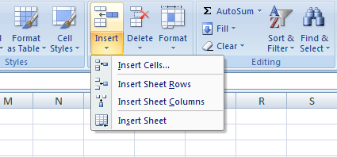
TO INSERT ROWS & COLOUMS
NOTE:
The new row always appears above the selected row.
The new column always appears to the left of the selected column.
TO INSERT ROWS:
Select the row below where you want the new row to appear.
Click the Insert command in the Cells group on the Home tab. The row will appear.
To Insert Columns:
Select the column to the right of where you want the column to appear.
Click the Insert command in the Cells group on the Home tab. The column will appear.

Slide 16
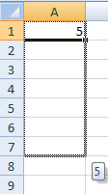
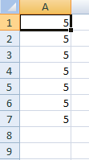

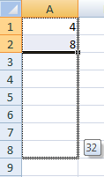
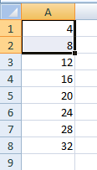
EDITING- FILL
IN THE LOWER RIGHT HAND CORNER OF THE ACTIVE CELL IS EXCEL’S “FILL HANDLE”.WHEN YOU HOLD YOUR MOUSE OVER THE TOP OF IT, YOUR CURSOR WILL TURN TO A CROSSHAIR.
IF YOU HAVE JUST ONE CELL SELECTED, IF YOU CLICK AND DRAG TO FILL DOWN A COLUMN OR ACROSS A ROW, IT WILL COPY THAT NUMBER OR TEXT TO EACH OF THE OTHER CELLS.
IF YOU HAVE TWO CELLS SELECTED, EXCEL WILL FILL IN A SERIES. IT WILL COMPLETE THE PATTERN.FOR EXAMPLE,IF YOU PUT 4 AND 8 IN TWO CELLS SELECT THEM,CLICK AND DRAG THE FILL HANDLE ,EXCEL WILL CONTINUE THE PATTERN WITH 12,16,20.ETC.
EXCEL CAN ALSO AUTO- FILL SERIES OF DATES, TIMES, DAYS OF THE WEEK, MONTHS.

Slide 17
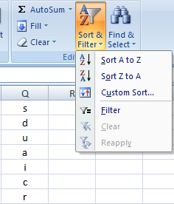

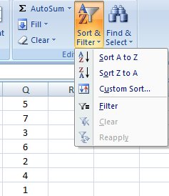

SORTING
TO SORT IN ALPHABETICAL ORDER:
Select a cell in the column you want to sort (In this example, we choose a cell in column Q).
Click the Sort & Filter command in the Editing group on the Home tab.
Select Sort A to Z. Now the information in the Category column is organized in alphabetical order.
TO SORT FROM SMALLEST TO LARGEST:
Select a cell in the column you want to sort (In this example, we choose a cell in column Q).
Click the Sort & Filter command in the Editing group on the Home tab.
Select From Smallest to Largest. Now the information is organized from the smallest to largest amount.

Slide 18


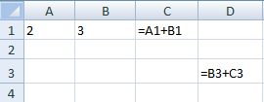
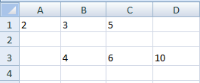
CELL REFERENCING
RELATIVE REFERENCE
A RELATIVE CELL REFERENCE AS (A1) IS BASED ON THE RELATIVE POSITION OF THE CELL. IF THE POSITION OF THE CELL THAT CONTAINS THE REFERENCE CHANGES, THE REFERENCE ITSELF IS CHANGED.
IN CELL (C1) SUM FUNCTION IS USED.
THEN FUNCTION FROM CELL (C1) IS COPY TO CELL (D3).
WHEN THE POSITION OF THE CELL IS CHANGED FROM (C1) TO (D3),THEN THE REFERENCE IS ALSO CHANGED FROM (A1,B1) TO (B3,C3).

Slide 19

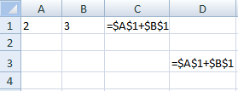
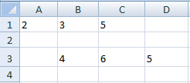
CELL REFERENCING
ABSOLUTE REFERENCE
AN ABSOLUTE CELL REFERENCE AS ($A$1) ALWAYS REFERS TO A CELL IN A SPECIFIC LOCATION. IF THE POSITION OF THE CELL THAT CONTAINS THE FORMULA CHANGES, THE ABSOLUTE REFERENCE REMAINS THE SAME.
IN CELL (C1) SUM FUNCTION IS USED.
THEN FUNCTION FROM CELL (C1) IS COPY TO CELL (D3).
WHEN THE POSITION OF THE CELL IS CHANGED FROM (C1) TO (D3),THEN THE ABSOLUTE REFERENCE REMAINS THE SAME(A1,B1).$ IS USED FOR CONSTANT ROW OR COLUMN.

Slide 20

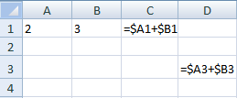
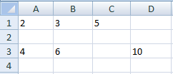
CELL REFERENCING
MIXED REFERENCE
A MIXED REFERENCE HAS EITHER AN ABSOLUTE COLUMN AND RELATIVE ROW OR ABSOLUTE ROW AND RELATIVE COLUMN. AN ABSOLUTE COLUMN REFERENCE TAKES THE FORM $A1, $B1.AN ABSOLUTE ROW REFERENCE TAKES THE FORM A$1, B$1.
IN CELL (C1) SUM FUNCTION IS USED.
THEN FUNCTION FROM CELL (C1) IS COPY TO CELL (D3).
WHEN THE POSITION OF THE CELL IS CHANGED FROM (C1) TO (D3),THEN ROW REFERENCE IS CHANGED(FROM 1 TO 3) BUT COLUMN REFERENCE REMAINS SAME(A,B).

Slide 21
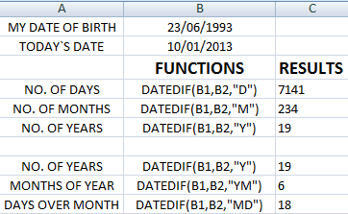
FUNCTIONS
DATEDIF FUNCTION
SYNTAX OF DATEDIF
=DATEDIF(START_DATE,END_DATE,”INTERVAL”)
START DATE-
Date from which u want to calculate difference.
END DATE-
Date up to which u want to calculate difference.
INTERVAL-
Form in which u want to calculate difference.
=
=
=
=
=
=
“D”- DAYS
“M”- MONTHS
“Y”- YEARS
“YM”- MONTHS OVER YEAR
“MD”- DAYS OVER MONTH
This says that I am 19 years 6 months & 18 days old

Slide 22
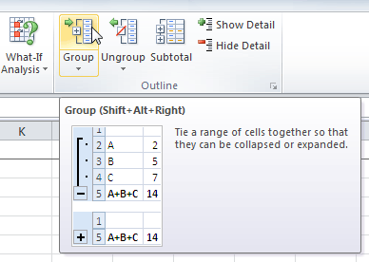
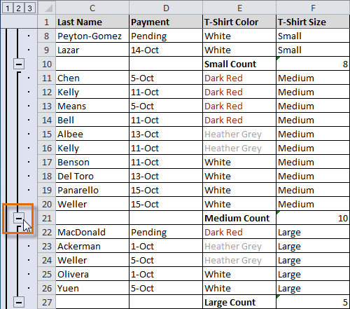
OUTLINING Cells
Outline/Group commands give you the ability to group any range of cells —either columns or rows.
It does not calculate a subtotal or rely on your data being sorted
It gives you the ability to show or hide any part of your worksheet and display only the information you need.

Slide 23
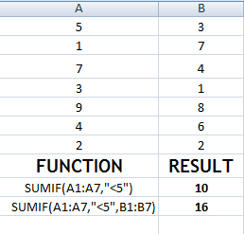
FUNCTIONS
SUMIF FUNCTION
SYNTAX OF SUMIF
=SUMIF(RANGE,CRITERIA,SUM_RANGE)
RANGE-
Range of cells on which conditions are applied.
CRITERIA-
Condition that defines which cell or cells will be added.
SUM RANGE-
Actual cells to sum.
NOTE:-
If sum range is not used then range is used for sum.
=
=
WITHOUT SUM_RANGE
WITH SUM_RANGE

Slide 24
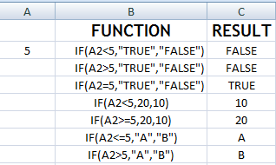
FUNCTIONS
IF FUNCTION
SYNTAX OF IF
=IF(LOGICAL TEXT, VALUE IF TRUE, VALUE IF FALSE)
LOGICAL TEXT-
Any value or expression that can be evaluated to TRUE or FALSE.
VALUE IF TRUE-
Value that is returned if logical text is TRUE.
VALUE IF FALSE-
Value that is returned if logical text is FALSE.
=
=
=
=
=
=
=
IN COLUMN B DIFFERENT CONDITIONS ARE USED AND BASED ON THIS, IN COLUMN C DIFFERENT RESULTS ARE SHOWN.

Slide 25
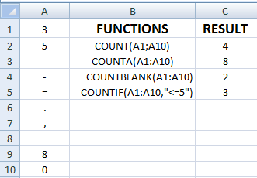
COUNT FUNCTIONS
SYNTAX OF FUNCTIONS
1. COUNT
=COUNT(VALUE1,VALUE2,…)
2. COUNTA
=COUNTA(VALUE1,VALUE2,…)
3. COUNTBLANK
=COUNTBLANK(RANGE)
4. COUNTIF
=COUNTIF(RANGE,CRITERIA)
=
=
=
=
1. 2. 3. 4.
COUNT ONLY CELLS THAT CONTAINS NUMBER.
COUNT CELLS THAT ARE NOT EMPTY.
COUNT CELLS THAT ARE BLANK.
COUNT NO. OF CELLS THAT MEET GIVEN CONDITION.

Slide 26
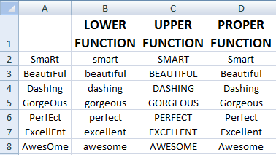
TEXT FUNCTIONS
SYNTAX OF FUNCTIONS
1. LOWER FUNCTION
=LOWER(TEXT)
2. UPPER FUNCTION
=UPPER(TEXT)
3. PROPER FUNCTION
=PROPER(TEXT)
1. 2. 3.
TO CONVERT TEXT FROM CAPITAL TO SMALL.
TO CONVERT TEXT FROM SMALL TO CAPITAL.
TO CAPITALISED EACH WORD OF TEXT.

Slide 27
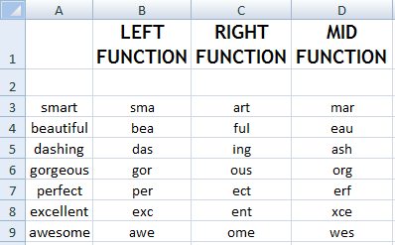
TEXT FUNCTIONS
SYNTAX OF FUNCTIONS
LEFT FUNCTION =LEFT(TEXT,NUM_CHARS)
RIGHT FUNCTION =RIGHT(TEXT,NUM_CHARS)
MID FUNCTION
=MID(TEXT,STARTNUM,NUM_CHAR)
=LEFT(A_{n} ,3)
=RIGHT(A_{n} ,3)
=MID(A_{n} ,2,3)
1. 2. 3.
RETURN SPECIFIED NO. OF CHARACTER FROM START OF TEXT.
RETURN SPECIFIED NO. OF CHRACTER FROM END OF TEXT.
RETURN CHARACTER FROM MIDDLE OF TEXT,GIVEN A STARTING POSITION.

Slide 28
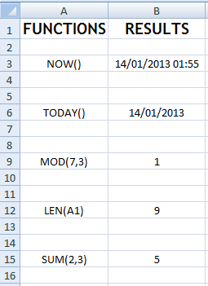
OTHER FUNCTIONS
USES OF FUNCTIONS
=
NOW RETURNS CURRENT DATE AND TIME.
TODAY RETURNS CURRENT DATE ONLY.
MOD RETURNS THE REMAINDER AFTER A NO.
IS DIVIDED BY A DIVISOR.
LEN RETURNS THE NO. OF CHARACTERS IN A
TEXT STRING.
SUM ADD ALL THE NUMBERS.
=
=
=
=

Slide 29
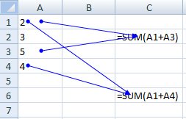
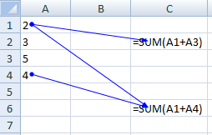
FUNCTION AUDITING
TRACE PRECEDENTS
SHOW ARROW THAT INDICATE WHAT CELLS AFFECT THE VALUE OF THE CURRENTLY SELECTED CELL.
IN THIS EXAMPLE CELLS A1 & A3 AFFECT THE VALUE OF CELL C2 & CELLS A1 & A4 AFFECT THE VALUE OF CELL C6.
TRACE DEPENDENTS
SHOW ARROW THAT INDICATE WHAT CELLS ARE AFFECTED BY THE VALUE OF THE CURRENTLY SELECTED CELL.
IN THIS EXAMPLE CELL C2 & C6 ARE AFFECTED BY THE VALUE OF CELL A2 & CELL C6 IS ALSO AFFECTED BY THE CELL A4.

Slide 30
SHORTCUT KEYS
PARTICULARS
EDIT THE ACTIVE CELL
CREATE A CHART
INSERT CELL COMMENT
FUNCTION DIALOGUE BOX
INSERT A NEW WORKSHEET
NAME MANAGER DIALOGUE BOX
VISUAL BASIC EDITOR
MACRO DIALOGUE BOX
HIDE THE SELECTED COLUMNS
UNHIDE THE COLUMNS
HIDE THE SELECTED ROWS
UNHIDE THE ROWS
SELECT ALL CELLS WITH COMMENT
KEYS
F₂
F₁₁
SHIFT + F₂
SHIFT + F₃
SHIFT + F₁₁
CTRL + F₃
ALT + F₁₁
ALT + F₈
CTRL + 0
CTRL + SHIFT + 0
CTRL + 9
CTRL + SHIFT + 9
CTRL + SHIFT + O

Slide 31
SHORTCUT KEYS
PARTICULARS
DOWN FILL
RIGHT FILL
ENTER SUM FUNCTION IN CELL
EURO SYMBOL
CENT SYMBOL
POUND SYMBOL
YEN SYMBOL
ENTER NEW LINE IN ACTIVE CELL
CURRENT DATE
CURRENT TIME
SHOW FORMULA
SELECT ENTIRE COLUMN
SELECT ENTIRE ROW
KEYS
CTRL + D
CTRL + R
ALT + =
ALT + 0128
ALT + 0162
ALT + 0163
ALT + 0165
ALT + ENTER
CTRL + ;
CTRL + SHIFT + ;
CTRL + `
CTRL + SPACEBAR
SHIFT + SPACEBAR

Slide 32
SHORTCUT KEYS
PARTICULARS
APPLIES NUMBER FORMAT
APPLIES CURRENCY FORMAT
APPLIES PERCENTAGE FORMAT
APPLIES EXPONENTIAL FORMAT
APPLIES GENERAL NO. FORMAT
APPLIES TIME FORMAT
APPLIES DATE FORMAT
APPLIES OUTLINE BORDER
REMOVE OUTLINE BORDER
KEYS
CTRL + SHIFT + !
CTRL + SHIFT + $
CTRL + SHIFT + %
CTRL + SHIFT + ^
CTRL + SHIFT + ~
CTRL + SHIFT + @
CTRL + SHIFT + #
CTRL + SHIFT + &
CTRL + SHIFT + _

Slide 33
Thank you

