Slide 1
End-Term Evaluation of the
National Strategic Health Development Plan (NSHDP) 1
(2010-2015)

Slide 2
Background
The NSHDP I (2010-2015) was developed through the active participation of all stakeholders, national and international (Federal, States, Development Partners, Civil Society Organisations, Academia etc);
Goal of NSHDP 1 : to significantly improve the health status of Nigerians through the development of a strengthened and sustainable health care delivery system
The plans have been implemented to varying degrees as confirmed by the Joint Annual and the Mid-Term Reviews that were regular features of the plans;

Slide 3
Objectives
The evaluation is to inform the development of NSHDP II, that will guide the activities of the health system over the next 5 years.
The objectives were to:
Measure and document the extent to which the targets for NSHDP 1 were achieved or on track,
Assess constraints and/or challenges encountered and solutions provided,
Draw best lessons learned and experiences gained, and
Develop recommendations to improve governance, management and implementation of activities to attain the NSHDP II goals.

Slide 4
Methodology-1
End-Term Evaluation (ETE) of the NSHDP 1 sub-group of the NSHDP II TWG was constituted and
  Chaired by the Head/M & E, DHPRS, FMOH and
  Co-chaired by Malaria Consortium (MC).
The ETE committee members:
Reps of FMOH, WHO, UNICEF, MC, AFNET, Measure Evaluation and HERFON
Committee’s main responsibility:
To deliver ETE report that will inform the situational analysis segment of the NSHDP II being developed.

Slide 5
Methodology-2
The ETE employed a mixed methodology of approaches:
A. Desk review
Reviewed relevant documents and references that informed the update of the results framework and progress regarding NSHDP 1 targets, especially since the MTR.
B. Semi-structured/qualitative interviews
Interviewed key stakeholders at the Fed, & State levels including govt. agencies &, development partners, NGOs, and CSOs

Slide 6
Results

Slide 7
Health Status of Nigerians-1
1. Life expectancy at birth:
2. Under-5 mortality rate:
3. Infant mortality rate:
4.Proportion of 1 year old immunized against measles
5 Prevalence of children under – 5 years of age who are underweight
6. Percentage of children under - 5 sleeping under insecticide-treated bed nets
7. Maternal mortality ratio
8. Adolescents Birth Rates
9. HIV prevalence among population aged 15-24 years

Slide 8
Life Expectancy at Birth (LEB)
LEB in Nigeria in 2009/10 was 49 years (WHO,2008).
The set targets were to achieve increase in LEB to 55, 63 and 70 years at 2011, 2013 and 2015 respectively.
In 2013, at MTR, LEB increased to 55 years (WHO, 2015)
In 2015, LEB about the same with 2013 at 54.5 years (WHO, 2016-); which fell short by a wide margin of the 2015 target of 70 years.
None of the targets set for periodic milestones was achieved in 5 years of the NSHDP 1.

Slide 9
Summary on the health status of Nigerians-1
The evaluation revealed that progress is being made, BUT
Achievements were lower than expected
The 2015 targets were largely unmet for most indicators.
Indicator with target met in 2015
  Adolescent birth rate: dropped from 126/1000 to 74/1000 adolescent women.
Indicators with target close to being met
  under-5 mortality rate and
  prevalence of underweight in children under-5

Slide 10
Summary on the health status of Nigerians-2
Indicator unacceptably poorer than projected
    Life expectancy at birth,
    Infant mortality rate,
    Measles immunization coverage,
    ITN utilization rate, and
    HIV prevalence among youth
Of the indicators on health status, only 1 was met, 2 close to being met, and 5 was not met
The set of indicators remain relevant to SDGs and should still be of priority in the NHSDP II

Slide 11
Leadership and Governance

Slide 12
Leadership and Governance of the Health Sector-1
The leadership and governance ( L&G)
Goal of the NSHDP 1 for L & G is to create and sustain an enabling environment for the delivery of quality health care & development in Nigeria.
The objectives of the NSHDP 1 for L & G were to have:
  improved strategic health plans implemented at federal and state levels; and
  transparent and accountable health systems management

Slide 13
Leadership and Governance of the Health Sector-2
The indicators for tracking progress included:
Having the National Health Act gazetted
Percentage of states adopting the National Health Bill (in their LGAs)
Percentage of states executing more than 70% of the annual non-personnel budget; and
The percentage of federal and states/FCT with published annual Health Watch Reports

Slide 14
Leadership and Governance of the Health Sector-3
Progress on the achievement of L& G Objectives
The National Health Act was gazetted in 2014
Other indicators for monitoring progress made in the L & G of the health sector are:
    far-fetched,
    difficult to measure and
    seemingly insensitive; no avenues for routine reporting
If states were to be visited to obtain data: Data not available in any particular office; several officials in different offices will have to be interviewed.
The L & G indicators need to be replaced

Slide 15
2. Health Service Delivery

Slide 16
Health Service Delivery-1
Goal of the NSHDP 1 for HSD was to
Revitalise integrated service delivery towards qualitative, equitable and sustainable health care..
The objectives of the NSHDP 1 for HSD were to :
Ensure universal access to an essential package of primary care services
Promote access to primary health services by the vulnerable populations
Improve the quality of primary health care services
Increase demand for primary health care services

Slide 17
Health Service Delivery- Analysis of Performance Indicators
Data were available for only 18 of the 26 performance indicators.
Achievements of these indicators are discussed in 3 sections namely:
  Child Health Services,
  Maternal Health Services, and
  Major Communicable Diseases, including Epidemic-Prone Diseases.

Slide 18
Health Service Delivery –Child Health (9).
Ind.#
21 | Malaria incidence among under-5 children
23 | Proportion. of 12-23 Months-Old Children Fully Immunised
24 | Percentage of children 6-59 months receiving vitamin A supplements twice a year
25 | Percentage of children under 6 months exclusively breastfed
26 | Percentage of under-5 children sleeping under ITN in the previous night(same as 6- discussed)
27 | Percentage of children under-5 with suspected pneumonia receiving appropriate treatment from a health provider.
28 | Percentage of newborns and mothers visited within 72 hours of delivery by a skilled health care provider – Data not available
29 | Percentage of children under-5 with suspected pneumonia receiving appropriate treatment from a health provider
30 | Prevalence of malaria in children under-5 years of age

Slide 19
Health Service Delivery –Maternal Health (7).
Ind.#
22 | Percentage of women with pregnancy within the last 2 years who received intermittent preventive treatment for malaria (IPTp)
32 | Unmet need for Family Planning
33 | Contraceptive Prevalence Rate (Modern)
34 | Percentage of pregnant women making at least 4 ANC visits according to standards
35 | Proportion of births attended by skilled health personnel
36 & 37 | Health care facilities providing basic emergency obstetric care and Case Fatality Rate among women with obstetric complications ( Data not available)

Slide 20
Health Service Delivery –Major Communicable Diseases Including Epidemic-prone Diseases(7)
.
Ind#
16 | Percentage of HIV infected pregnant women who receive ARV prophylaxis to reduce the risk of MTCT
17 | Proportion of population with advanced HIV infection and access to antiretroviral drugs
18 | Prevalence of tuberculosis
19 | Proportion of tuberculosis cases cured under directly observed treatment short course
20 | TB case Detection rate under directly observed treatment short course
31 | Number of new wild poliovirus cases
39 | Reduction in Case Fatality Rate resulting from epidemic outbreaks/emergencies

Slide 21
Health Service Delivery
Progress on the achievement of Health Service Delivery
Of the 18 service delivery indicators with available data, the target for 2015 was partially met for 2 indicators related to
  ANC, and
  the interruption of wild polio virus
in the context of the SDGs and the national health policy, all service delivery indicators remain very relevant.

Slide 22
Health Care Financing and Reforms

Slide 24
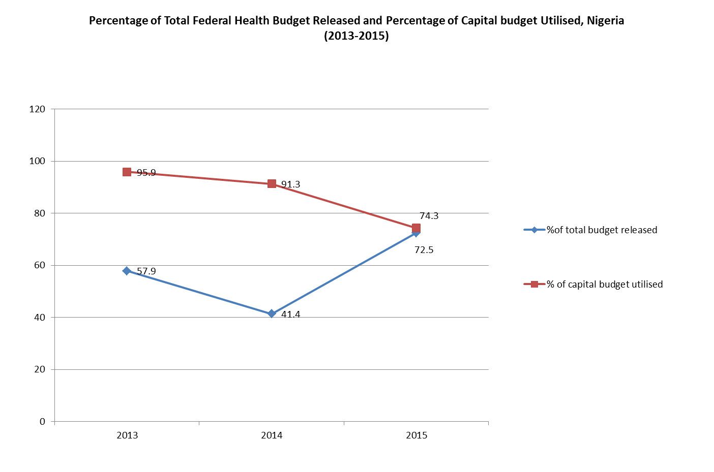

Slide 25
Challenges/Lessons learnt

Slide 26
Challenges/Lessons learnt
No emphasis on health in the provisions of the current National Constitution (1999)
No clear roles and responsibilities of the 3-tiers of government in health systems management and delivery
Even the National Health Act (2014) has not fully addressed the gaps in health governance

Slide 27
Challenges/Lessons learnt (2)
Poor coordination and harmonization of various national health coordination platforms
Indicators for monitoring the progress in the leadership and governance of the health sector are far-fetched, difficult to measure and seemingly insensitive
No avenues for the routine reporting of these indicators

Slide 28
Challenges/Lessons learnt (3)
7. Inadequate political will & commitment to health, as evidenced by low budgetary allocation to health at all levels of government
8. Ineffective coordination among the 3 level of government & between the private and public sectors Lack of effective mechanisms for engaging consumers in policy and plan development, and implementation
9. Weak donor coordination and harmonization of donor aid.
10. Low level of government financing of healthcare, at the three levels (< 35% of total health expenditure is contributed by govt)

Slide 29
Challenges/Lessons learnt (5)
12. High level of out-pocket spending (OOPS) in the country (>65% of payment for health service is from OOPS)
13. Low level of coverage of health insurance and other pre-payment and financial risk protection mechanisms.
Inequity in health financing and inefficiencies in use of health resources.
Slow implementation of the National Health Act – with provision of the Basic Health care Provision Fund (BHCPF)
Governance and accountability weaknesses in generation and use of health financing resources.
Weak Primary Health Care structures

Slide 30
Challenges with implementation of SHDP 1 (Contd.)
20. Weak M & E systems to track the indicators for measuring progress in the implementation of the SHDP
21. Vertical programming and reporting system
22.Lack of political will and programme ownership at the level of the states and LGAs
23. Poor mobilization and belated disbursement of counterpart budget by fed, state, & LGA actors

Slide 31
Recommendations-1
Amendment of the National Health Act (2014) to give clear roles and responsibilities all tiers of govt on health matters.
  Amendments to the 1999 constitution equally important in this regard.
Government to make budgetary allocations to health to achieve the “Abuja Declaration”
  Incremental allocation of at least 15% of national budget to health.

Slide 32
Recommendations-2
Amend the NHIS Act to ensure all employers cover their employees with health insurance
  make provisions for funding by employers both in public and private sector
  provision to be enshrined in the constitution
Establish govt health services of Nigeria fund (Basket Fund for the health sector). The fund :
  To be based on the provisions of the NSHDP
  To be contributed by all donors, centrally
  Will improve govt. coordination of donor funds,
  Will prevent duplication of efforts and discourage vertical programming.

Slide 33
Recommendations-3
Address the health inequity in Nigeria. Govt. to
  Revitalize PHC structures, governance and services,
  Refurbishing/constructing PHC facilities is good BUT
  Staffing, drugs and supplies, functioning utilities and quality assurance are needed.
Adopt the 2016 WHO recommendation on ANC which changed Focus Antenatal Care to antenatal care for a positive pregnancy experience.
  Increase number of “contacts” with a skilled provider to 8 from the 4 “visits”

Slide 34
Recommendations-3
Allocate a percentage of revenues from value added tax and/or other taxes to health.
  Increasing coverage with health insurance and other financial risk protection mechanisms to at least 50% over the next 4 years is highly recommended
  Review objectives and key indicators for health systems and align with SDGs and Nat health policy

Slide 35
Recommendations-3
Objectives and Indicators
To keep focus on SDGs and National Health Policy
Review objectives and key indicators for health systems and align with SDGs and Nat health policy.
Address Urban rural disparity in Results
  Revitalize PHC structures, governance and services,
  Refurbishing/constructing PHC facilities is good BUT
  Staffing, drugs and supplies, functioning utilities and quality assurance are needed

Slide 36
Going into the next phase of NSHDP
Costing:
Need for clear methodology that is user friendly, allow for common understanding by partners; allows for ease of integration of funds.
  . Progress on the achievement of objectives and milestones need to be clear and measurable
    E.g Leadership and governance indicators are difficult to measure; need to be revised/ replaced.

Slide 37
Going into the next phase of NSHDP
  Set up coordination and harmonisation platforms (including better involvement of private sector),
    agree on their ToRs and membership and support their operationalization for better synergy and avoidance of duplication of efforts
Data
No data nor mechanism to collect data for some service delivery indicators
Better gathering and use of evidence for more government funding, better utilisation of existing resources and more accurate targeting of resources.

Slide 38
Thank you for your attention!

